Slide 1
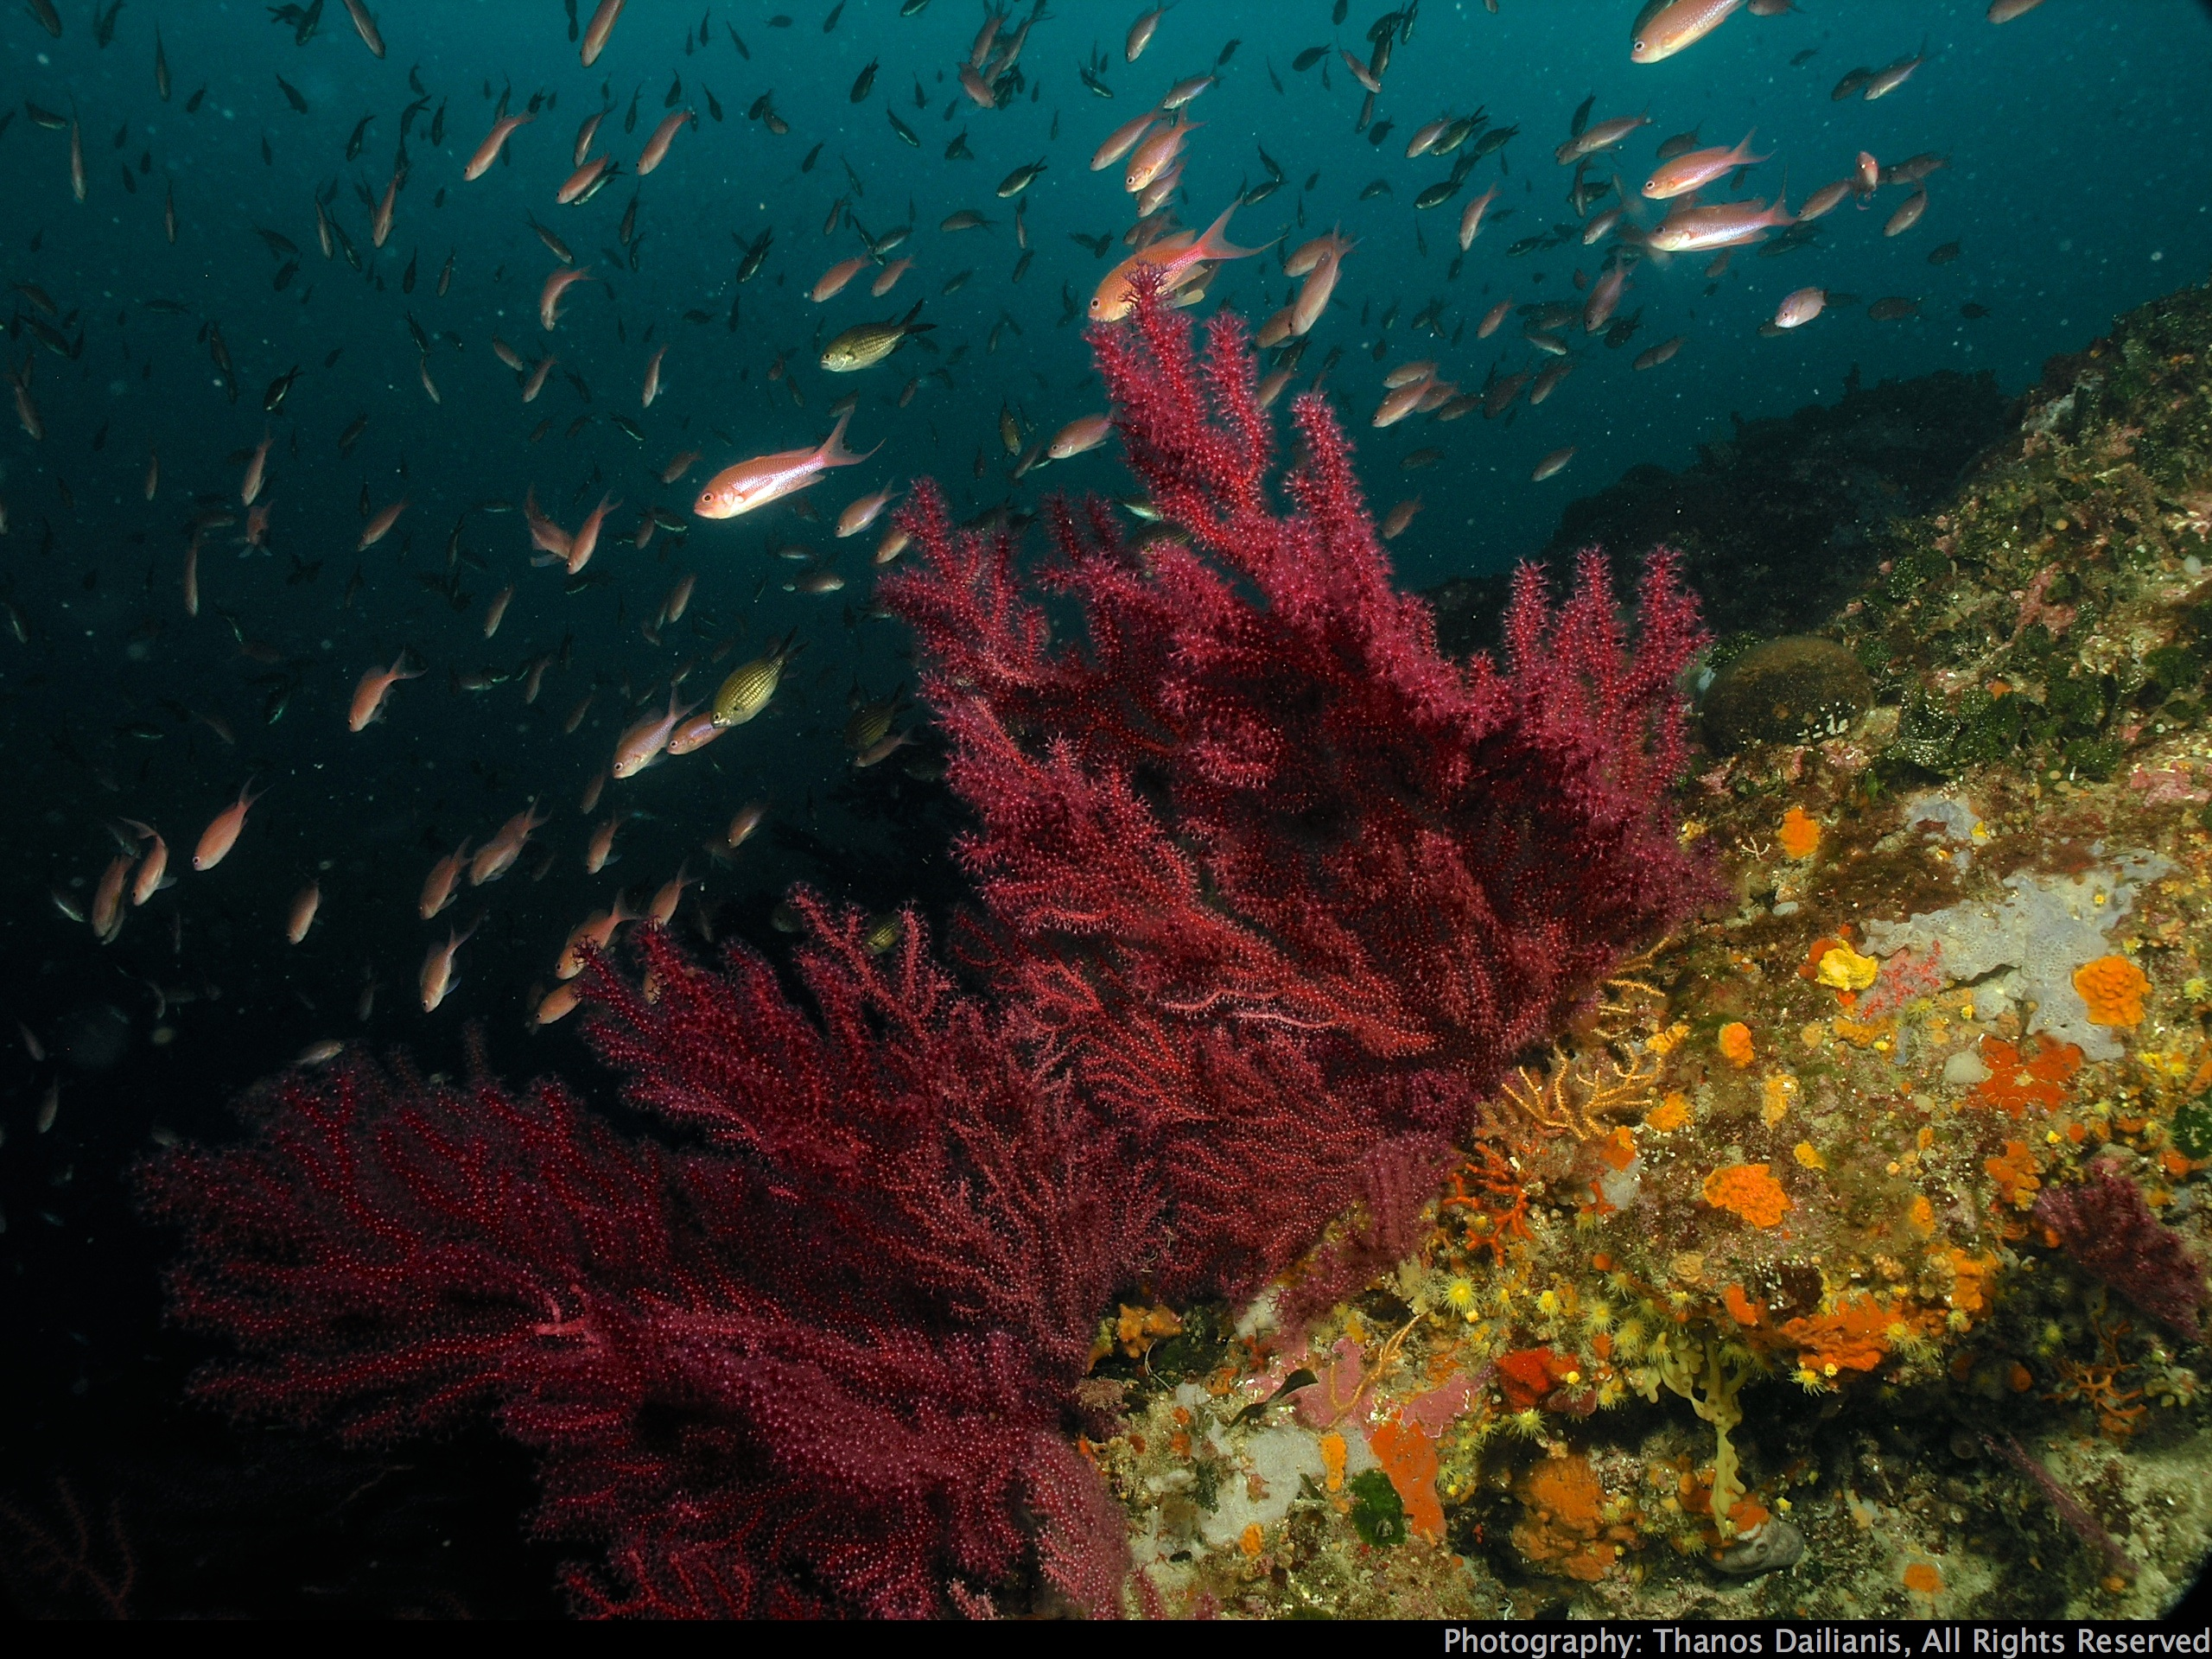
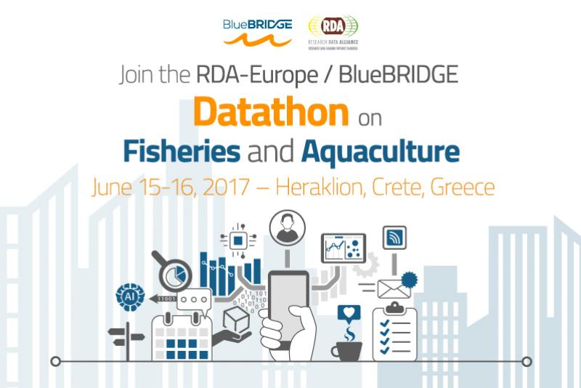
HCMR, Heraklion, Crete
IMBBC
Institute of Marine Biology,
Biotechnology and Aquaculture
Hellenic Centre for Marine Research
(HCMR)
Institute of Marine Biology, Biotechnology and Aquaculture (IMBBC)
A. Magoulas, Director
15 - 16 June, 2017

Slide 2
The
Hellenic Centre for Marine Research
(HCMR)

Slide 3
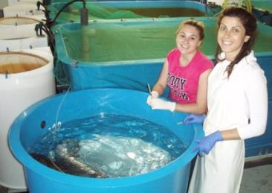
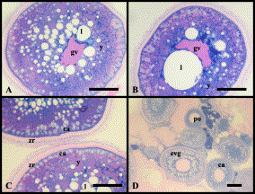
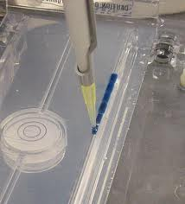
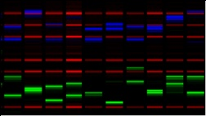
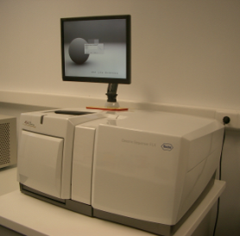
Hellenic Centre for Marine Research (HCMR)
2012: Second round of mergings (Law 4051 / 2012)
Research Institutes
Board of Directors
Aquaria
Oceanography
Marine Biological Resources
Aquaculture
Marine Biology and Genetics
Inland Waters
Institute of
Oceanography (IO)
Institute of Marine Biological Resources and Inland Waters, (IMBRIW)
Institute of Marine Biology, Biotechnology and Aquaculture (IMBBC)
Support Units
Administrative & Financial
Research & Documentation
Technological development & promotion

Slide 4
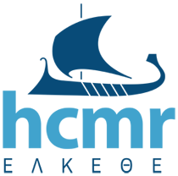
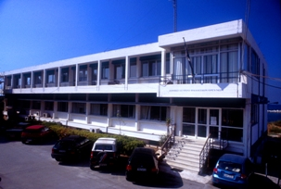
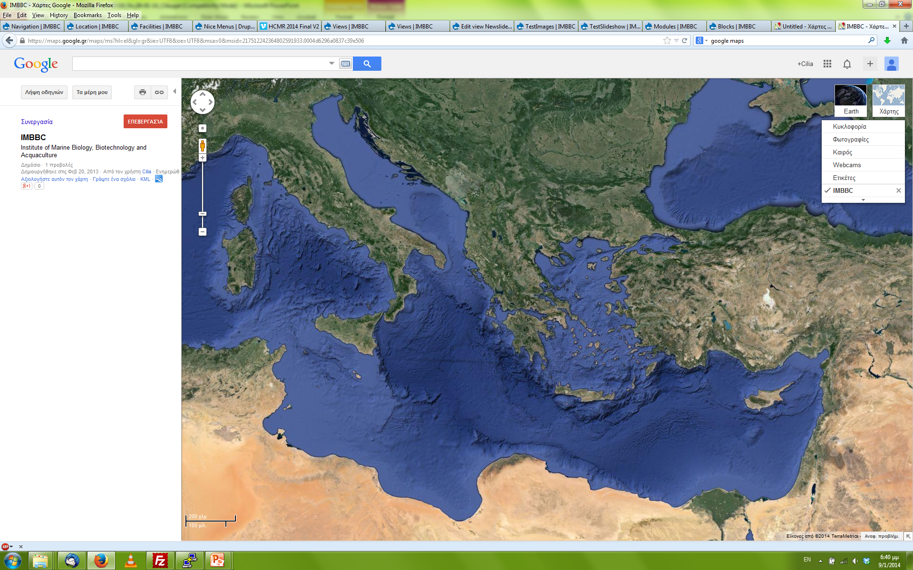
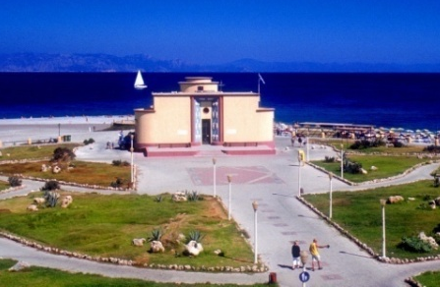
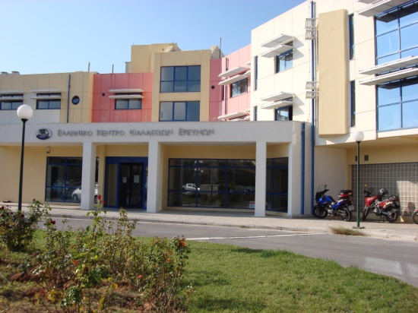
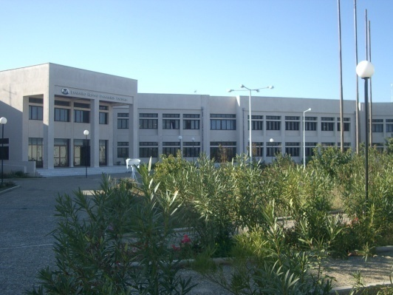
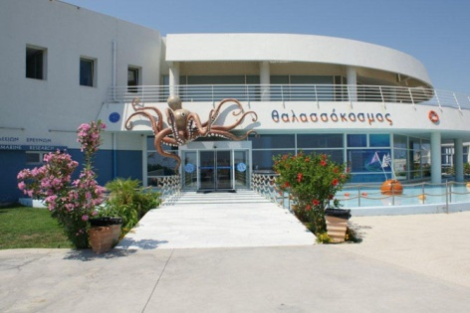

Hellenic Centre for Marine Research (HCMR)
Greece

Slide 5
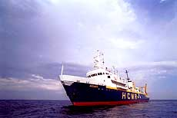
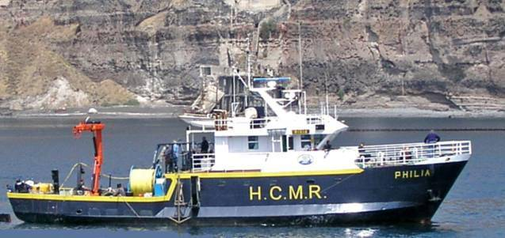
Hellenic Centre for Marine Research (HCMR)
Three research Vessels
Aegaio (61.50 m)
Philia (26.10 m)
Alkyon (13.40 m)

Slide 6
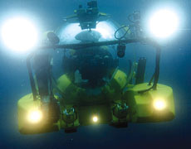
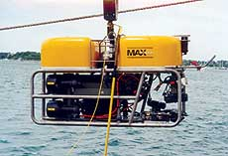
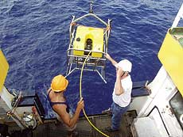
Hellenic Centre for Marine Research (HCMR)
A 2-man submersible: THETIS
Operational depth: 610 m
Five deepwater ROVs:
Max Rover: Maximum operational depth:
2000 m

Slide 7
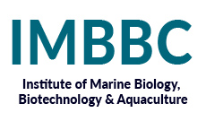
The
Institute of Marine Biology, Biotechnology and Aquaculture
(IMBBC)

Slide 8
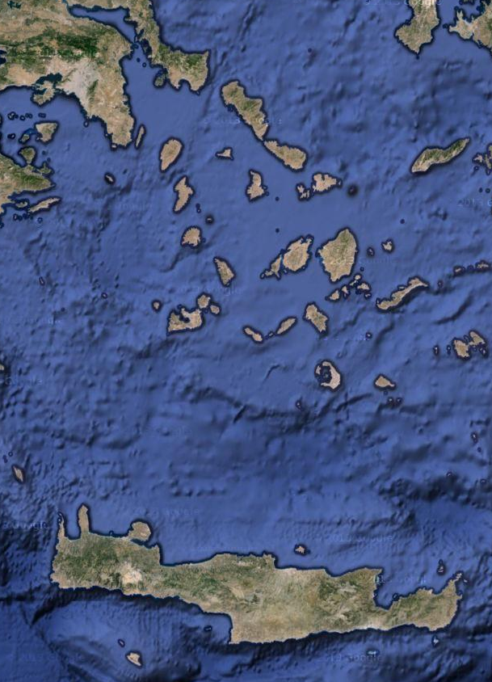

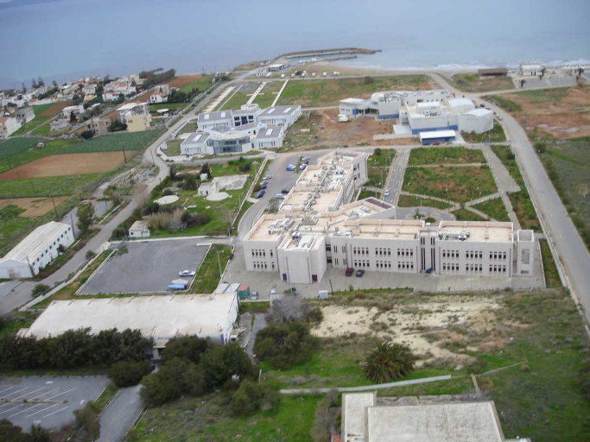

Institute of Marine Biology,
Biotechnology and Aquaculture (IMBBC)
Personnel: ~ 100 persons
Researchers: 22

Slide 9
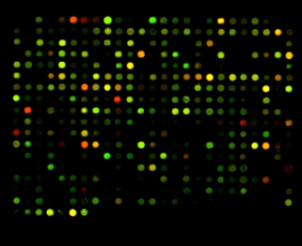
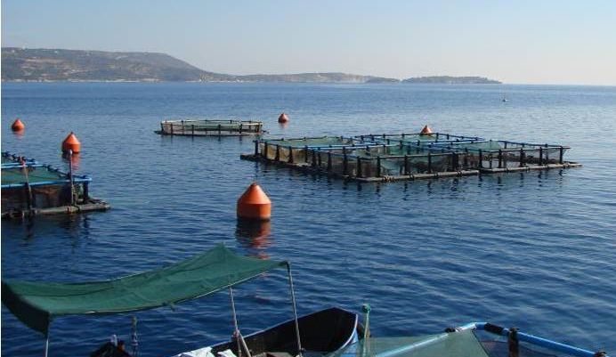
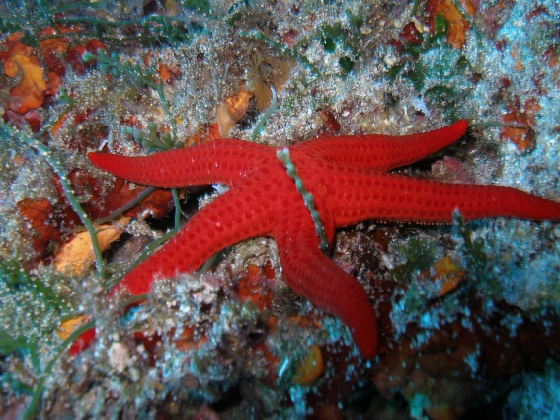
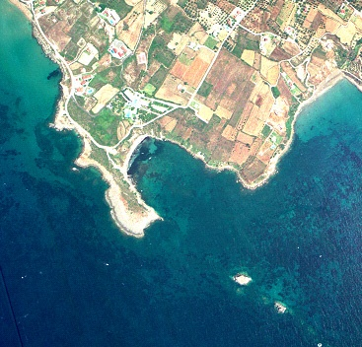
Institute of Marine Biology,
Biotechnology and Aquaculture (IMBBC)
Main research directions
  I. Genetics and molecular biotechnology
  II. Biodiversity and ecosystem management
  III. Aquaculture
Horizontal units
Bioinformatics and electronic infrastructures
Environmental chemistry and microbiology
Bioanalysis and biotechnology

Slide 10
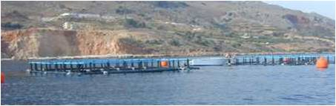
Institute of Marine Biology,
Biotechnology and Aquaculture (IMBBC)
Services
Species identification and authentication of origin by use of genetic methods
Quality assessment of marine and fresh waters, bathing sea waters (service to the authorities), drinking water (service to bottling companies)
Parentage identification and MAS in aquaculture
Technical assistance to fish farms (husbandry, pathology)

Slide 11
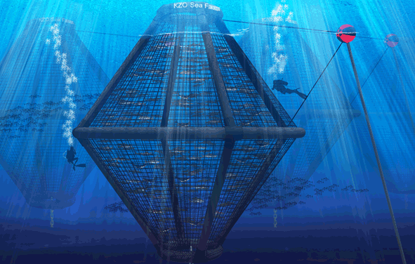
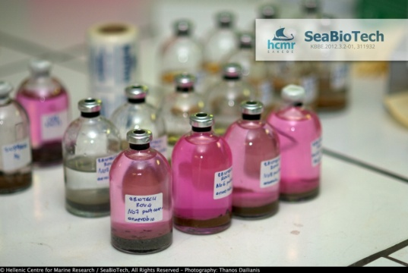
Institute of Marine Biology,
Biotechnology and Aquaculture (IMBBC)
Products
Eggs, juveniles, and edible fish
Hormonal implants for reproduction in captivity
Autogenous vaccines to cure disease in aquaculture

Slide 12
Main projects
related to production, storage, analysis and presentation of data
Notes:
Projects related to production, storage analysis and presentation of data

Slide 13

FP 7/ Capacity /REGPOT
MARBIGEN: Supporting research potential for MARine BIodiversity and GENomics in the Eastern Mediterranean
Funding: 2,926,000 Euros / 2,250,000 Euros EU contribution
Duration: 2010- 2014
MARBIGEN’s web site:
http://www.marbigen.org

Slide 14


ESFRI Roadmap
ESFRI roadmap (2008)
Social Sc. & Hum. ( 5 ) | Life Sciences ( 13 ) |  | Environmental Sciences ( 9 ) |  | Energy ( 7 ) | Material and Analytical Facilities ( 6 ) | Physics and Astronomy ( 10 ) |  | e-Infra- structures (1)
SHARE | BBMRI | ELIXIR | ICOS | *EURO-ARGO | ECCSEL | EUROFEL | ELI | TIARA* | PRACE
European Social Survey | ECRIN | INFRA FRONTIER | *LIFE-WATCH | IAGOS | Windscanner | EMFL | SPIRAL2 | CTA
CESSDA | INSTRUCT | EATRIS | *EMSO | EPOS | EU-SOLARIS | European XFEL | E-ELT | SKA
CLARIN | EU-OPENSCREEN | *EMBRC | SIAEOS | EISCAT_3D | JHR | ESRF Upgrade | KM3NeT | FAIR
DARIAH | Euro BioImaging | ERINHA BSL4 Lab |  | COPAL | IFMIF | NEUTRON ESS | SLHC-PP* | ILC-HIGRADE*
 | ISBE | MIRRI |  |  | HiPER | ILL20/20 Upgrade
 | ANAEE |  |  |  | MYRRHA
I.O.
I.O.
 | Distributed research infrastructures
 | Single sited research infrastructures

Slide 15
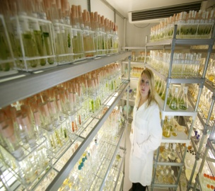
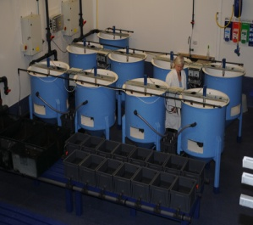
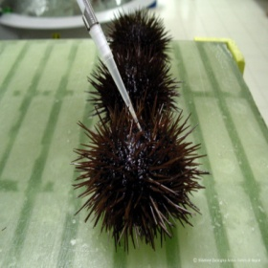
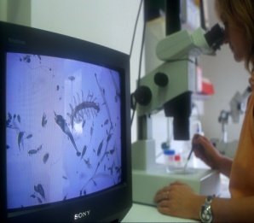

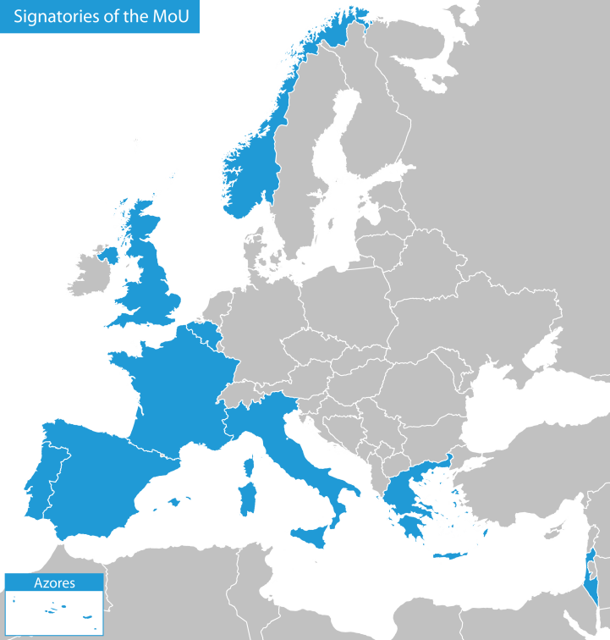

ESFRI Infrastructures
Model organisms
Platforms
Experimental aquaria and mesocosms
Ecosystems
Omics approaches
  EMBRC - ERIC: EUROPEAN MARINE BIOLOGICAL RESOURCE CENTRE
  Responding to the global societal grand challenges
  through
  advanced marine biology and ecology research
  Biomedicine
  Sustainability of food production
  Industrial process innovation
  Environmental adaptations to climate and pollution
Notes:
EMBRC-ERIC Status, May 2016
+ training
Open to industry, policy, academia
EMBRC has completed its Preparatory Phase (PP), which ran from February 2011 to February 2014, funded by the European Union under the 7th Framework Programme for Research Infrastructures. During PP, EMBRC developed a blueprint of the infrastructure including a plan for EMBRC activities and services, governance structure and business plan.
Since March 2014, EMBRC is in its Implementation Phase (IP), with nine countries signatories of a MoU (France, UK, Italy, Portugal, Spain, Belgium, Greece, Norway, Israel) for the establishment of a European Research Infrastructure Consortium (ERIC), hosted by France, with headquarters in Paris.
The Executive Director of the EMBRC-ERIC, Dr. Ilaria Nardello, has been appointed in September 2015, to support the ERIC application process, with the finalization of the EMBRC-ERIC statues, the Technical and Scientific Description and a five year operational budget. The first step of that application has been formally concluded in March 2015, with the submission of these documents to the European Commission.
In the meanwhile, the Secretariat premises have opened at Place Jussieu, hosted at the Université Pierre et Marie Curie – Paris 6th, in the heart of Paris; and the Secretariat staff is being recruited.
EMBRC is very active pursuing funding opportunities and has applied for INFRAIA-2016-17 under the topic “Marine Biological Stations”. Acquired funding include contributions from the EU H2020 Framework Programme for Research Infrastructures: PP2EMBRC (European Marine Biology Resource Centre preparatory phase 2); EMBRIC (European Marine Biological Research Infrastructure Cluster to promote the Blue Bioeconomy); CORBEL (Coordinated Research Infrastructures Building Enduring Life-science services).
While some services are already available to the user community, such as, for example, the 'European Marine Training Portal' (www.marinetraining.eu), EMBRC is expected to become fully operational (Operational Phase, OP) in 2017, with the establishment of EMBRC as a legal entity, in the form of a European Research Infrastructure Consortium (ERIC)"

Slide 16
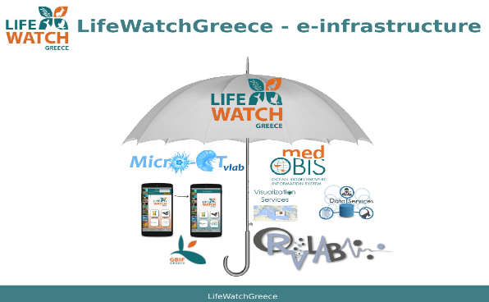

ESFRI Infrastructures
LifeWatch-ERIC
E-Science European Infrastructure for Biodiversity and Ecosystem research
Data grid
Monitoring sites
Collections
Computing grid
Funding: 3,7 M€
IMBBC leads a consortium of > 50 Greek partners

Slide 17
ESFRI Infrastructures
ELIXIR-Greece
Marine Genomics is one of the two use cases of ELIXIR-GR
Euro- Bioimaging-Greece
Cyber taxonomy
Bioimaging and software development at HCMR for “Virtual taxonomy”
Links with LifeWatch

Slide 18

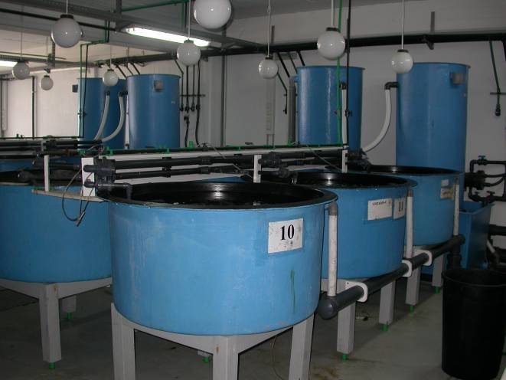
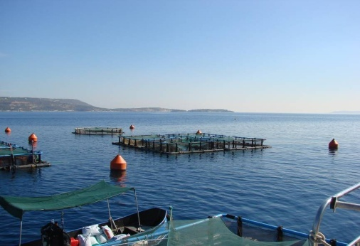
I3 projects
AQUAEXCEL – AQUAEXCEL 2020
Aquaculture infrastructures for excellence in European fish research
(FP7 - H2020)
Objectives: Coordination of the highest-class European aquaculture research facilities covering the entire range of production systems, environments, scales, fish species, and fields of expertise (nutrition, physiology, health and welfare, genetics, monitoring and management technologies and engineering)
Aqualabs
Souda bay

Slide 19
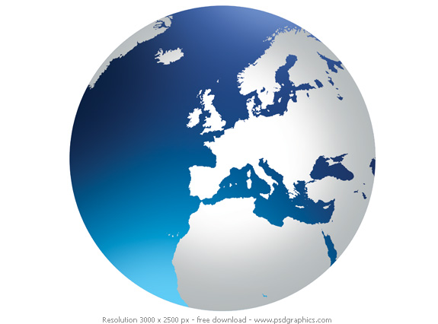
ASSEMBLE+ (H2020)
Transnational Access to facilities of 21 Institutes – funded through biannual calls
Single entry point to access services (TNA)
Improving access provision
Improving virtual access to marine biological stations’ data, information and knowledge
Fostering knowledge transfer: engaging with user communities
Long-term sustainability of marine biological stations
JRAs
Genomic observatories (lead by IMBBC)
Cryobanking of marine organisms
R&D on cryopreservation and biobanking of macroalgae
Functional genomics: protocols and vectors for mutagenesis and knock-out using CRISPR/Cas9 genome editing
Development and standardization of on-site instrumentation for experimental marine biology and ecology
Emerging technologies to improve diving-based science delivery

Slide 20
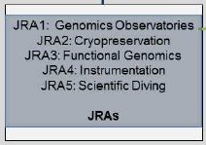
Genomics Observatories (GOs) in ASSEMBLE+
19 marine stations: 16 along Europe and one for each of Red Sea, Antarctic and Arctic ocean (coordination by HCMR)
Crete Greece, Eilat Israel, Piran Slovenia, Naples Italy, Banyuls France, Faro Portugal, Vigo
Spain, Basque country Spain, Roscoff France, Plymouth UK, Antarctic UK, Galway Ireland, Ostend Belgium, Helgoland Germany, Gdansk, Poland, Arctic Poland, Tvärminne Finland, Goteborg Sweden
Support by
EMBRC,
LIFEWATCH,
ELIXIR
The first long term network of GOs is the European one!
Metagenomics: bacteria - viruses
Metatranscriptomics: bacteria - eukaryotes
Metabarcoding: prokaryotes - eukaryotes
Notes:
Genomics Observatories (Gos):
Securing long-term oceans monitoring
It is a Genomics Standards Consortium Project
Goal: Establishment of Long-Term Monitoring of marine ecosystems by combining: Genomics and Environmental data and standardized procedures
First secured funding, 4 year funding, has been by FP7 Micro B3 project: Ocean Day Sampling:
21Dec, 21 June, for three years
First long term funding –to be implemented in the EMBRC research infrastructure
Assemble+ funded «Genomics Observatories»: The first long term network of GOs is the European one,
Data Work flows developed in MicroB3 will be implemented in EMBRC
Coordinated by IMBBC-HCMR

Slide 21
Projects
EMODnet: European Marine Observation and Data Network
EMODnet Biology
SPARCOMP: Comparative transcriptomics in four sparid species using next generation sequencing and comparative mapping based on available genetic information from model species
ANNOTATE: Analysis of multi-functional genes and their paralogs in teleosts: identification, evolution and annotation through transcriptome scans and functional studies

Slide 22


Projects
Micro B3: Biodiversity, Bioinformatics, Biotechnology
Data integration [genomics + environmental] and analysis
32 academic and industrial partners
Coordinator: University of Bremen (Germany)
From OSD to GOs
SeaBioTech: From sea-bed to test-bed: harvesting the potential of marine biodiversity for industrial biotechnology
Metagenomics of extreme environments
~ 600 K€
14 academic and industrial partners
Coordinator: Strathclyde University (UK)
Metagenomics of extreme environments & sponge symbiotes
Establishment of bacterial collection

Slide 23
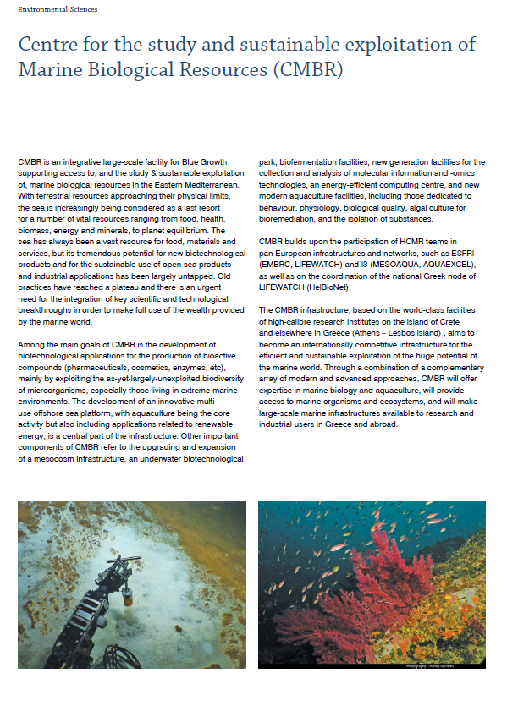
CMBR
CMBR: Centre for the study and sustainable exploitation of Marine Biological Resources
Greek Roadmap for research infrastructures
Blue Growth
Multi-use Offshore Sea Platform
Genomic Observatories
Facilities for biotechnological applications
Energy-efficient computing centre
Mesocosms
Duration: 2017-2020

Slide 24
CMBR – omics platform
The facility:
Next Generation Sequencing platform (Illumina, Ion Proton, Oxford Nanopore): IMBBC-HCMR, IMBB -FORTH
Proteomics facility: IMBB-FORTH
Metabolomics Facility: Univ. of Athens - School of Pharmacy, IMBBC-HCMR
Metabolic engineering in heterologous vectors: UoC, Medical School
Bioassays (antimicrobial, anticancer, anti-inflammatory, anti-oxidant assays): UoC, Medical School
Bioinformatics: IMBBC-HCMR, IMBB-FORTH
Bioreactors: IMBBC/HCMR, IMBB-FORTH
Highthroughput real time monitoring of strain growth: IMBBC-HCMR
The platform will be optimized for producing systems-biology destined data on cultivable strains, and –omics data on environmental samples
Main targets: bacteria and eukaryotic microbes
Links to ELIXIR Marine Use Case

Slide 25
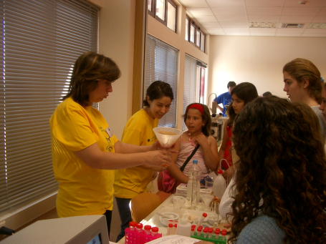
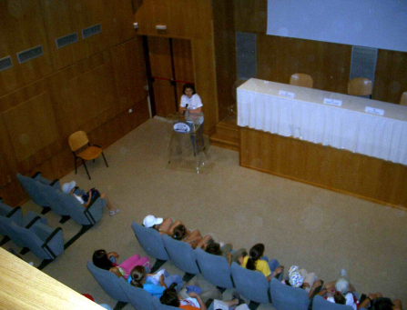
Data training activities
9 training courses/ year, including at least one 2-week summer school
EMBO Practical Course “Computational molecular evolution” (COME)
Every two years in Crete, alternating with Hinxton,
Cambridge, UK
CreteIDEA collaborative workshop
EMDONET WS’s
GSC18 meeting
LifeWatch data manager training WS’s

Slide 26
Interactive-type events
3 hackathons on metagenomics, text mining and statistical analysis (2012, 2013, 2014), which resulted in a peer –reviewed publication (COST funded)
Bluehackathon (2013)
The Genomics Standards Consortium 18 (GSC 18) was combined with the ISD (Island Sampling Day): in a single day, exactly one year ago, 15th June 2016, 26 participants formed 10 teams that collected soil and plant samples from 72 sites at different types of environments, elevations, etc
MicroB3 summer school (2014), in which practical training (sampling and sample processing, metadata collection) and theoretical training (data analysis, scientific background) were given
Notes:
Δυαδραστικοί τύποι συνεδρίων/δραστηριοτήτων, σε αντιστοιχία του Datathon:
Based on the ability of IMBBC to support both theoretical (e.g. speeches) and practical (hands-on training, sampling) type of activities, special importance has been given to the development of new types of collaboration, training and synthesis of knowledge and skills
Με βάση τη δυνατότητα του ΙΘΑΒΒΥΚ ΕΛΚΕΘΕ να υποστηρίξει: τοσο "θεωρητικές" δραστηριότητες (πχ ομιλίες) όσο και "πρακτικές" δραστηριότητες (πχ. hands on training, sampling) σημαντική βαρύτητα έχει δωθεί στην ανάδειξη νέων τρόπων συνεργασιών, εκπαίδευσης και σύνθεσης γνώσης/δεξιοτήτων

Slide 27
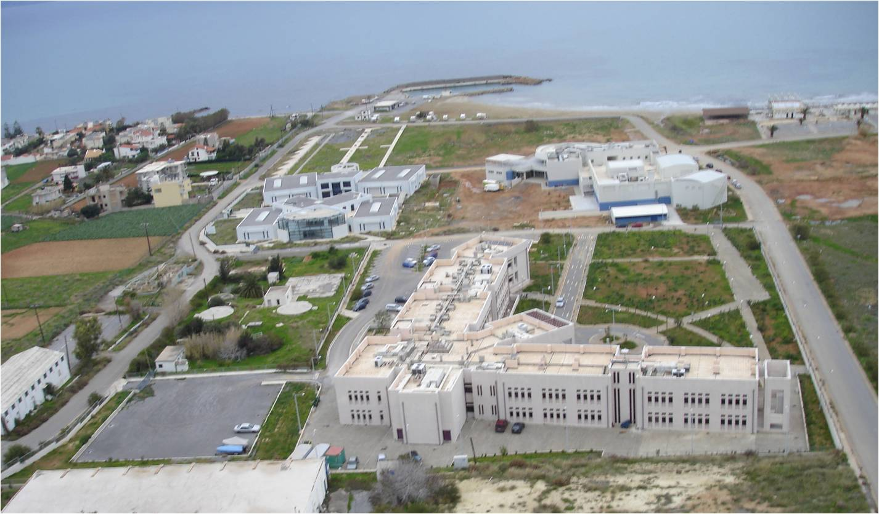
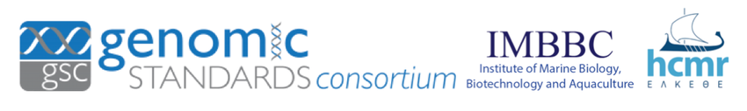
Thank you for your attention!
Thank you for your attention!

