Slide 1
Spectral Imaging of Coastal Environments
Gregory Tsagkatakis
Signal Processing Laboratory
Institute of Computer Science (ICS)
Foundation for Research and Technology – Hellas (FORTH)
http://www.spl.edu.gr/

Slide 2
Outline
Spectral Imaging
Machine Learning
Applications in Costal monitoring
PHySIS project
Imaging | Learning | Applications | PHySIS project

Slide 3

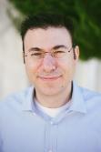
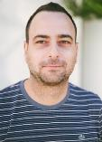

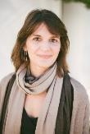
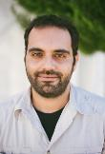
Signal Processing Lab
Prof. P. Tsakalides, head, Statistical Signal Processing
Prof. A. Mouchtaris
Audio and Speech Processing
N. Stefanakis, PhD, Audio Signal Processing
G. Tzagkarakis, PhD Statistical Signal Processing
A. Panousopoulou, PhD, Wireless Sensor Networks
G. Tsagkatakis, PhD Imaging Technologies
Imaging | Learning | Applications | PHySIS project

Slide 4
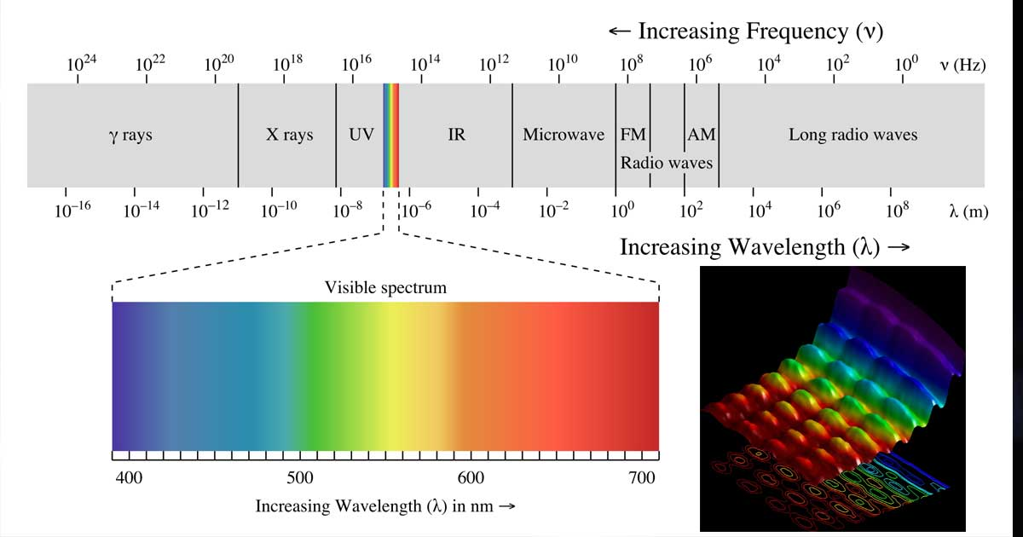
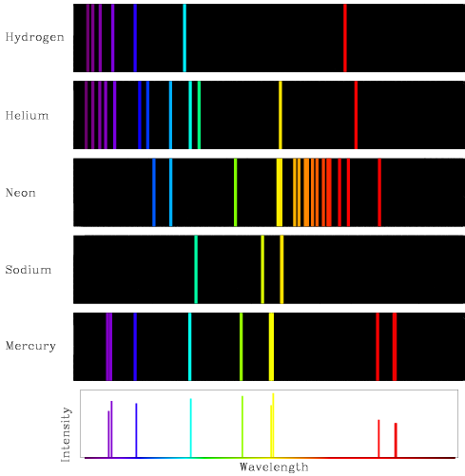
Imaging
EM spectrum
Emission/Absorption spectra
Plankton blooms swirl in the North Atlantic Ocean (Envisat MERIS, May 2010)
Imaging | Learning | Applications | PHySIS project

Slide 5
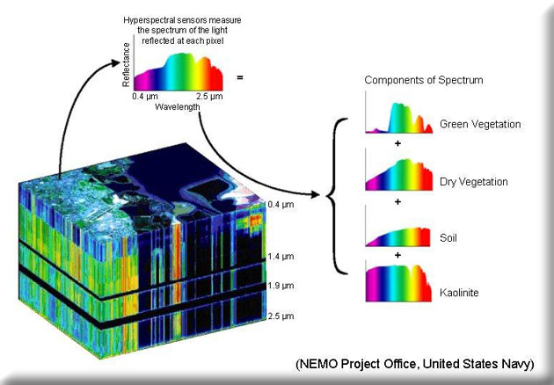
Hyperspectral imaging
Multispectral Imaging / Spectroscopy
Imaging | Learning | Applications | PHySIS project

Slide 6
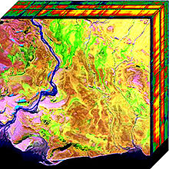
Hyperspectral imaging
Spatial scanning
Spatial location
Spatial
Patch scanning
Spectral band
Spectral
Spatial
Spectral scanning
Imaging | Learning | Applications | PHySIS project

Slide 7
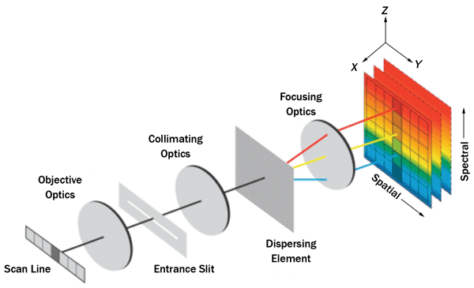
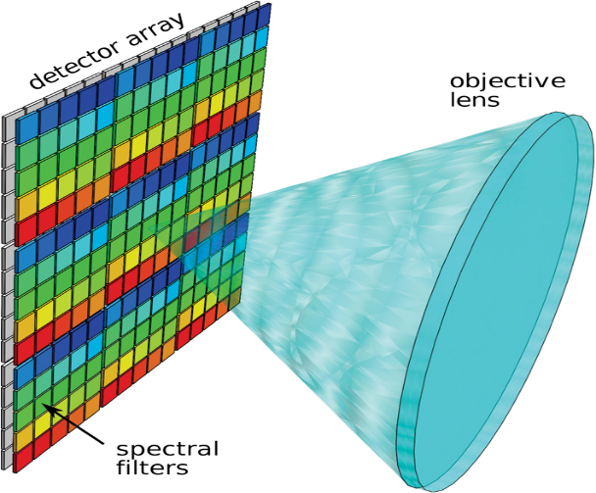
Spectral Imaging
Linescan Sensors
+ Spectral resolution
Spatial resolution
Temporal resolution
Snapshot Spectral Imaging
+/- Spectral resolution
+/- Spatial resolution
+ Temporal resolution
Imaging | Learning | Applications | PHySIS project

Slide 8
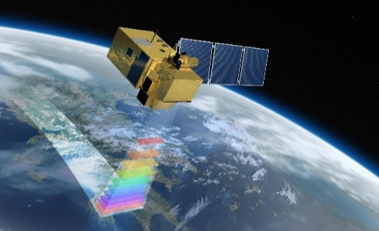
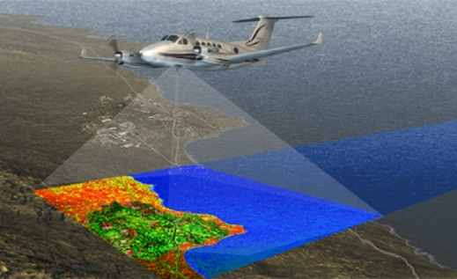
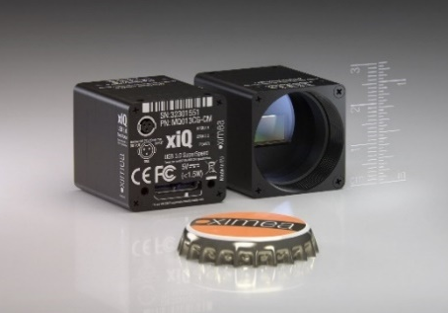
Remote Sensing Platforms
 | Satellites | Aerial | Mobile
Resolution | Low | Medium | High
Revisit | High | Low | High
Cost | Medium | High | Low
Imaging | Learning | Applications | PHySIS project

Slide 9
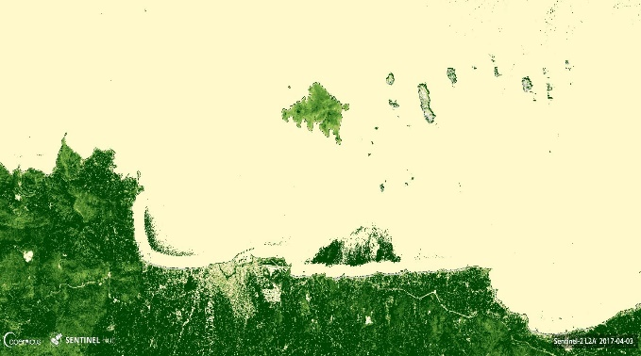
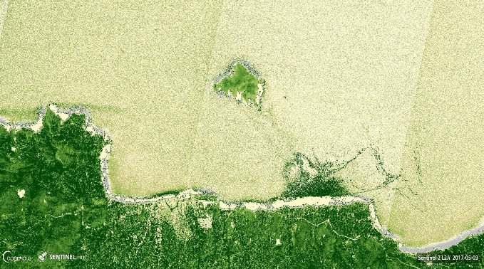
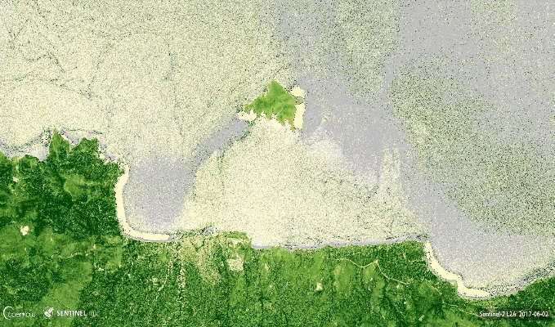
Copernicus & Sentinels
Platform | Mission | State
S1 | Synthetic Aperture Radar | 2014, 2016
S2 | Multispectral Imaging | 2015, 2017
S3 | Imaging & Altimetry | 2016, 2018
S4 | Atmospheric Chemistry | 2021
S5 | Atmospheric Chemistry | 2017, 2021
S6 | Altimetry | 2020
Imaging | Learning | Applications | PHySIS project

Slide 10
Copernicus Data
> 6 TB of core products generated daily
> 100 TB of products disseminated daily
Imaging | Learning | Applications | PHySIS project

Slide 11
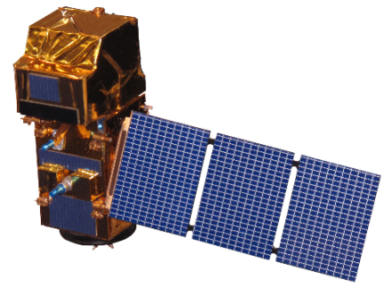
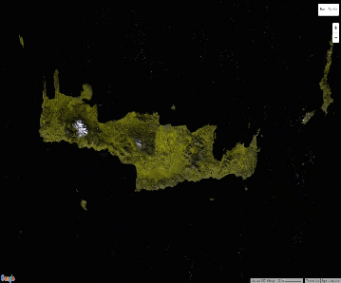
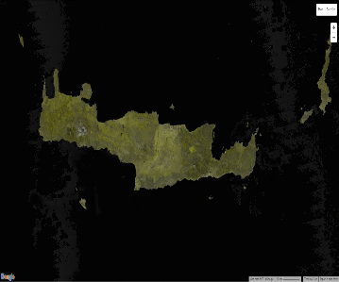
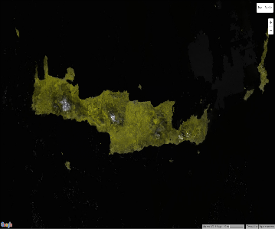
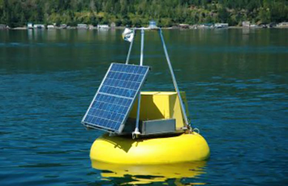
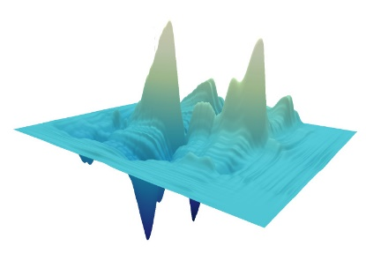
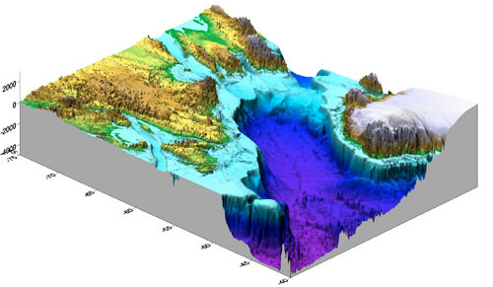
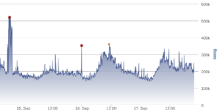
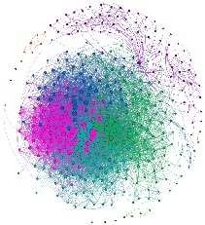
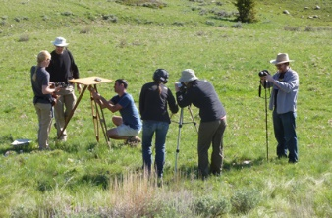
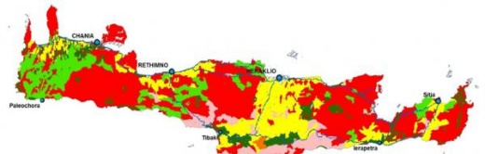

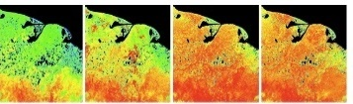
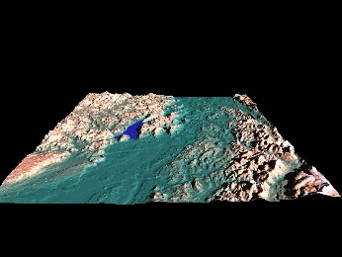
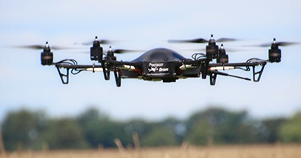
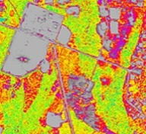
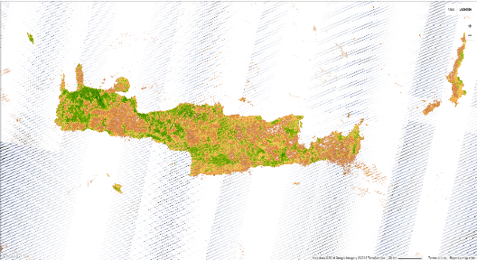
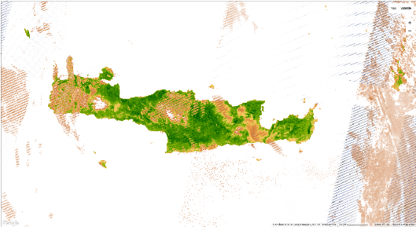
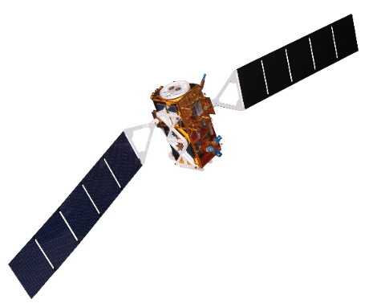
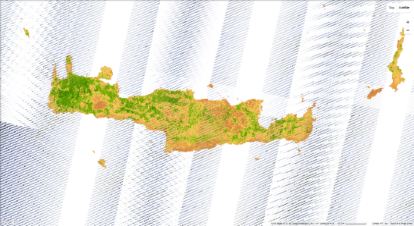
Big Earth Observation Data
Volume
Big, Heterogeneous Sensor Data Integrative Processing
Variety
Value
Precision agriculture
Climate change
Veracity
Learn & Infer
Co-analyze & Fuse
Velocity
Model & Enhance
Imaging | Learning | Applications | PHySIS project

Slide 12
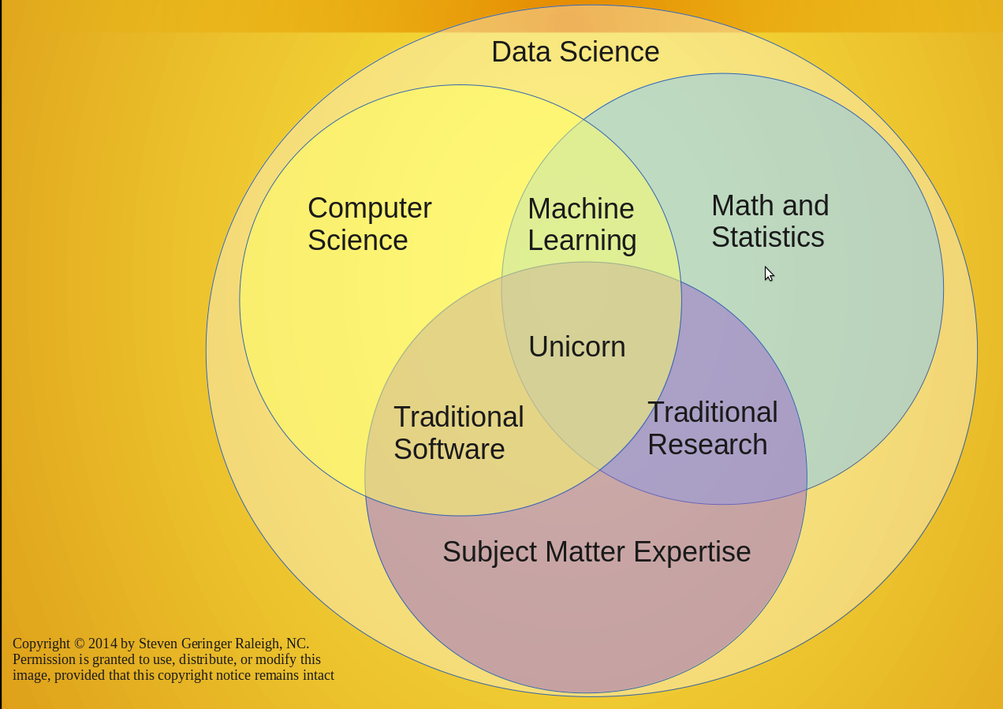
Machine Learning
“To give the computers the ability to learn without being explicitly programmed“, Arthur Samuel, 1959
Imaging | Learning | Applications | PHySIS project

Slide 13
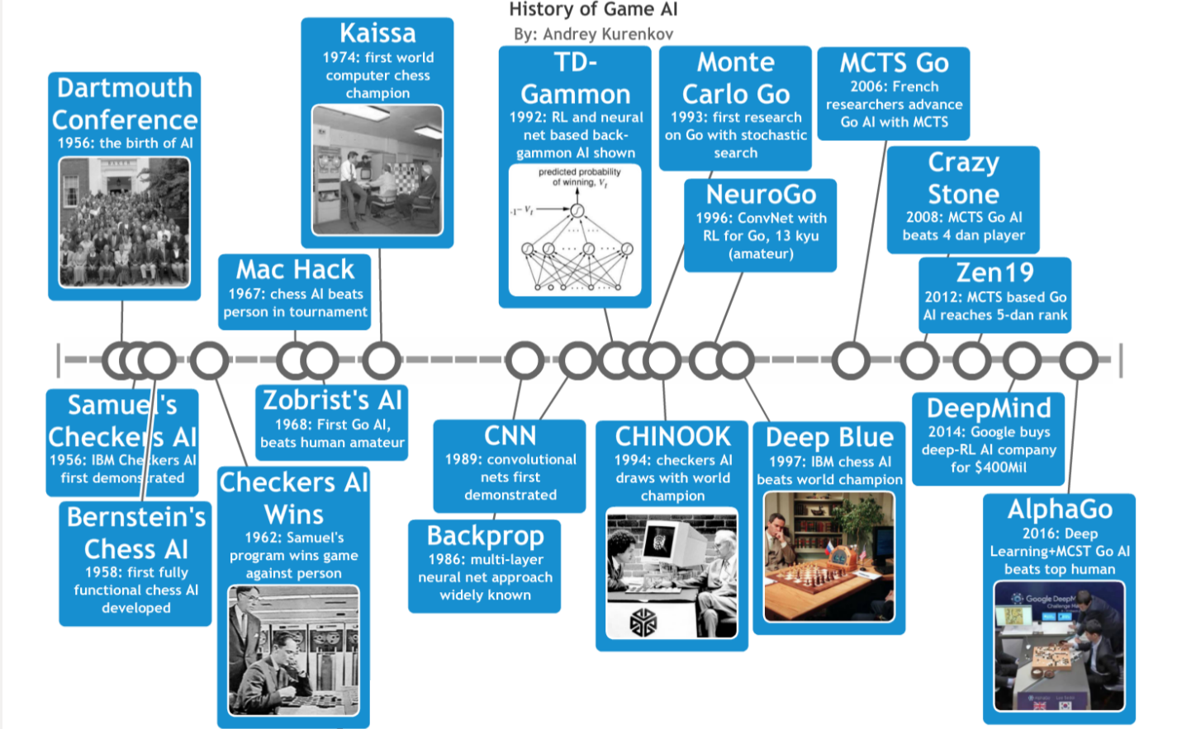
Imaging | Learning | Applications | PHySIS project

Slide 14
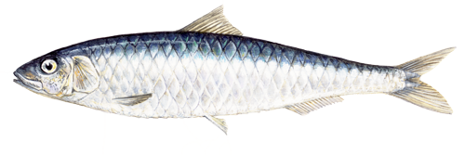
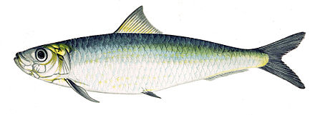
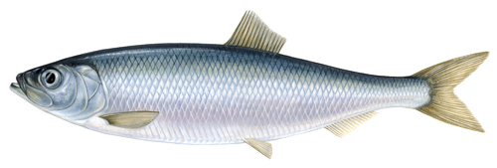
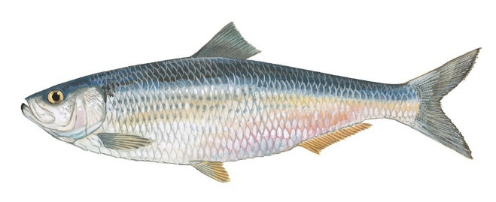
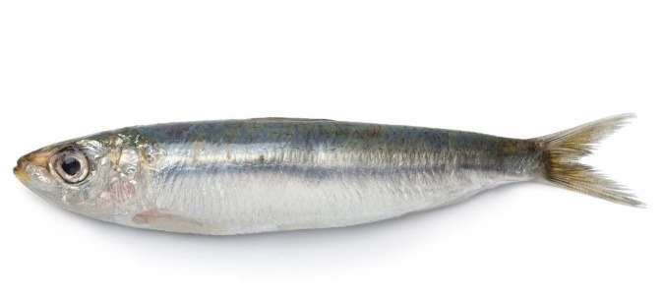
Types of Machine Learning
Supervised
Sardine
Sardine
Training data
Herring
Herring
Test data
?
Imaging | Learning | Applications | PHySIS project

Slide 15
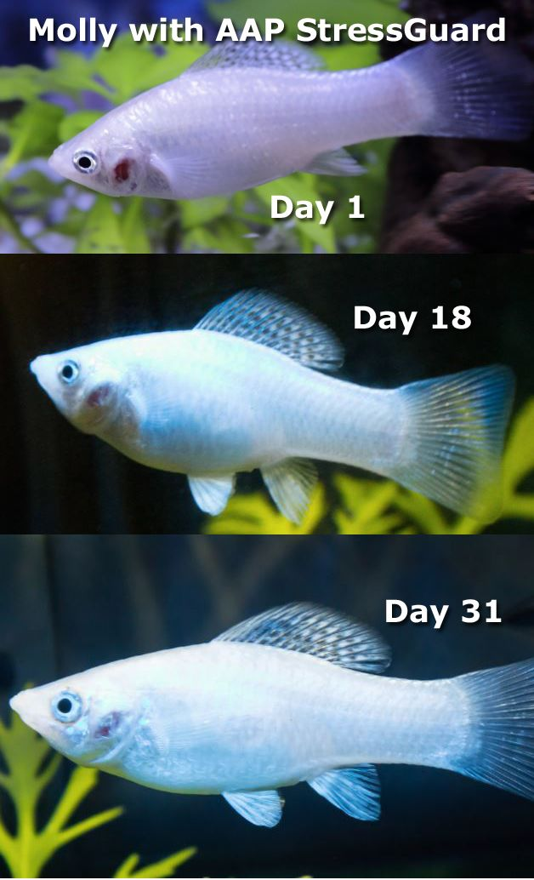
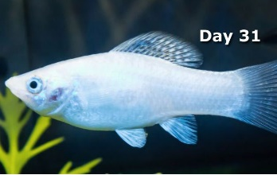
Types of Machine Learning
Supervised
Unsupervised
Imaging | Learning | Applications | PHySIS project

Slide 16
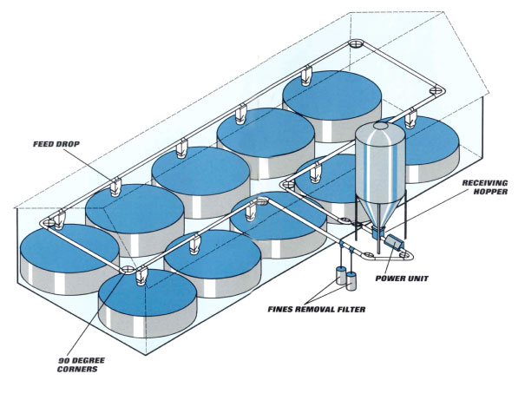
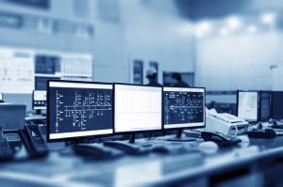
Types of Machine Learning
Supervised
Unsupervised
Reinforcement learning
Sensing
Control
Imaging | Learning | Applications | PHySIS project

Slide 17

Deep Learning
hand-crafted feature extractor
“Simple” Trainable Classifier
Past
output
Present
Imaging | Learning | Applications | PHySIS project

Slide 18
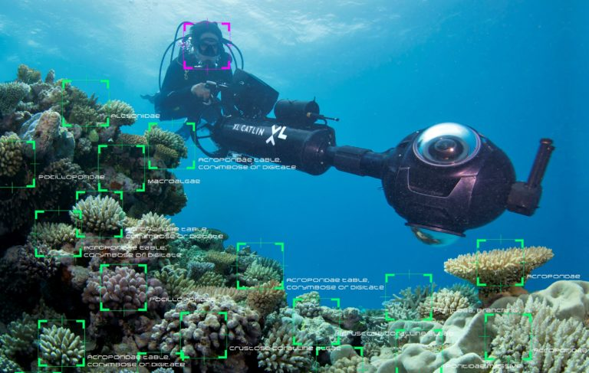
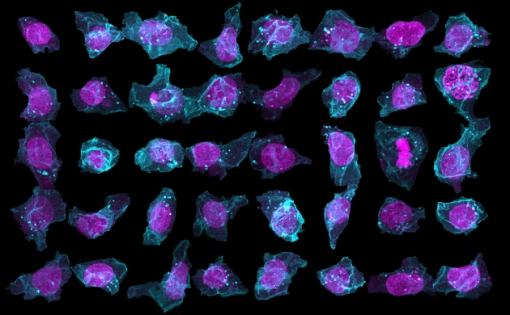
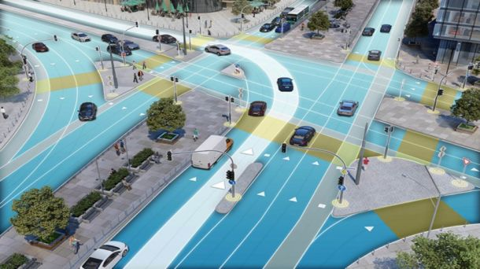
Applications
Imaging
Life science
Autonomous Vehicle
Remote Sensing
Imaging | Learning | Applications | PHySIS project

Slide 19
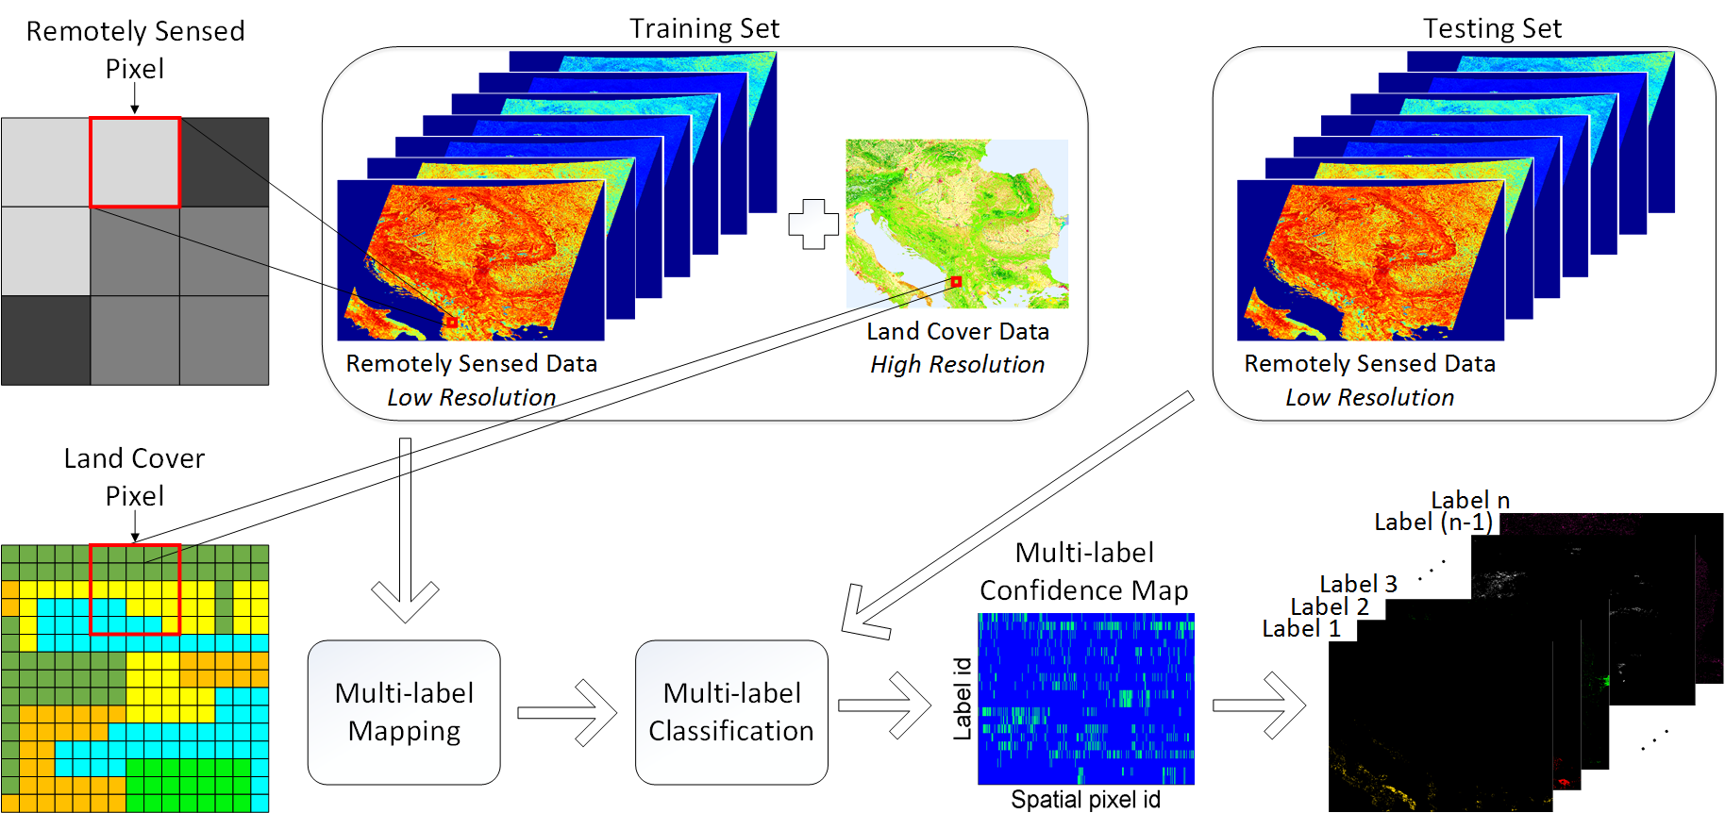




Machine Learning in EO
Scenario
  Up-to-date Land Cover Estimation
Challenges
  Labor intensive field measurements
  Outdated annotated datasets
Dataset
  MODIS 36 bands (NASA Terra & Aqua)
  Corine Land Cover (CLC) by EEA
Imaging | Learning | Applications | PHySIS project

Slide 20
Multi-label Land Cover Learning
Imaging | Learning | Applications | PHySIS project

Slide 21
System | Purpose | Technique
Machine vision system | Fish sorting | Morphological features (size, volume, weight)
 |  | Size and fish area image
 |  | Measuring length, shape and determining fish species
 | Fish quality | Skin colour
 |  | Changes in area, shape and thickness
 |  | Freshness
Hyperspectral imaging system | Physical attributes | Fat distribution
 |  | Texture
 |  | Freshness
 | Chemical attributes | pH
 |  | Fat content
 |  | Moisture
 | Food security | Microbial spoilage
 |  | Lactic acid bacteria
Imaging | Learning | Applications | PHySIS project

Slide 22


Hyperspectral in EO
Applications
Multi-source data fusion
Single/Multi label classification
Change/Anomaly detection
Recovery/Prediction
Sentinel – 3
timely measurements of the state of the ocean surface, including surface temperature, water quality and pollution monitoring.
Imaging | Learning | Applications | PHySIS project

Slide 23
Remote sensing & aquaculture
Suitability map for offshore bivalve aquaculture in the Bay of Plenty, NZ incorporated SST and Chl-a estimates (AVHRR, SeaWIFS(Longdill et al. 2008c)
Data garden
Bathymetric information,
sea floor mapping,
currents,
upwelling,
harmful algal blooms
Imaging | Learning | Applications | PHySIS project

Slide 24
Market
Satellites can support aquaculture farmers and policy makers by:
identifying suitable sites
issuing warnings on potential water quality threats (e.g. pollution and harmful algal blooms)
monitoring the environmental impact of sea farms
Mathiassen, John Reidar, et al. "Trends in application of imaging technologies to inspection of fish and fish products." Trends in Food Science & Technology 22.6 (2011): 257-275.
Imaging | Learning | Applications | PHySIS project

Slide 25






PHySIS: Sparse Signal Processing Technologies for
Hyperspectral Imaging Systems
H2020-COMPET-6-2014
Bottom-up space technologies at low TRL
http://www.physis-project.eu/
Imaging | Learning | Applications | PHySIS project

Slide 26





Key Targeted Innovations
CEA
Space Exploration
IMEC
Imaging Technology
NOA
Earth Observation
FORTH
Algorithms & Applications
PLANETEK
Systems Design
Imaging | Learning | Applications | PHySIS project

Slide 27





The PHySIS platform
Camera Setup: Acquisition Process
Output: Snapshot Mosaic Image
Imaging | Learning | Applications | PHySIS project

Slide 28
Datathon dataset
Minnow fishes
  25 band images in range 680-970nm
  Acquisition: Day 1, Day 2, Day 5 and Day 7
https://github.com/spl-icsforth/Hyperspectral_imaging_fish
Imaging | Learning | Applications | PHySIS project

Slide 29
Thank you!
http://www.physis-project.eu/ www.spl.edu.gr #spl_lab

